Slide 1
SALES DEPARTMENT

Slide 2

ProblemStatement
**Problem Statement:**
The sales department of XYZ Corporation is facing challenges in optimizing their sales strategies across different regions. Despite a significant investment in marketing and sales promotions, there has been an inconsistent performance in terms of revenue generation and customer acquisition. The department is particularly concerned about the following issues:
Declining Sales in Specific Regions: Sales have been steadily declining in certain regions, and the department is unable to pinpoint the reasons behind this trend.
Low Conversion Rates: While the company is receiving a high number of leads, the conversion rate from leads to actual sales is low, leading to a significant loss of potential revenue.

Slide 3
Linear Regression Single Variate
Linear regression is a statistical method used to model the relationship between a dependent variable and one or more independent variables by fitting a linear equation to observed data. The goal is to predict the value of the dependent variable based on the values of the independent variables, minimizing the sum of the squared differences between the observed and predicted values.

Slide 4
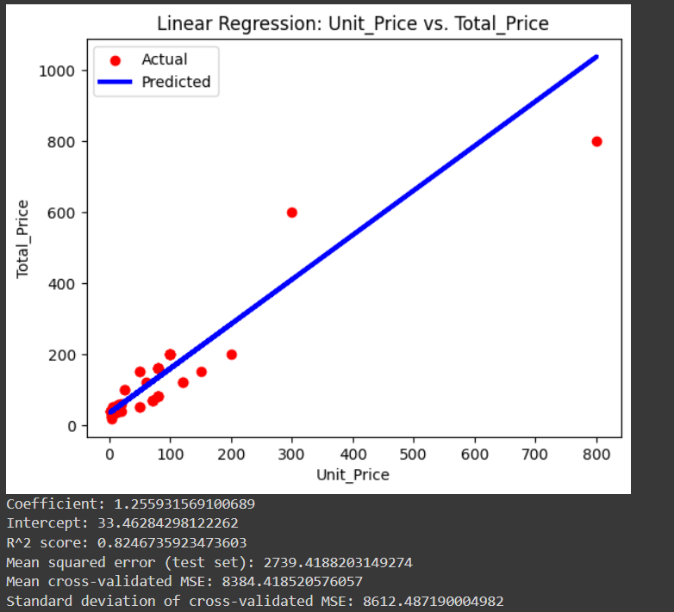

Slide 5
Linear Regression MultiVariate
Multivariate linear regression is a statistical technique used to model the relationship between a dependent variable and multiple independent variables by fitting a linear equation to the observed data.

Slide 6
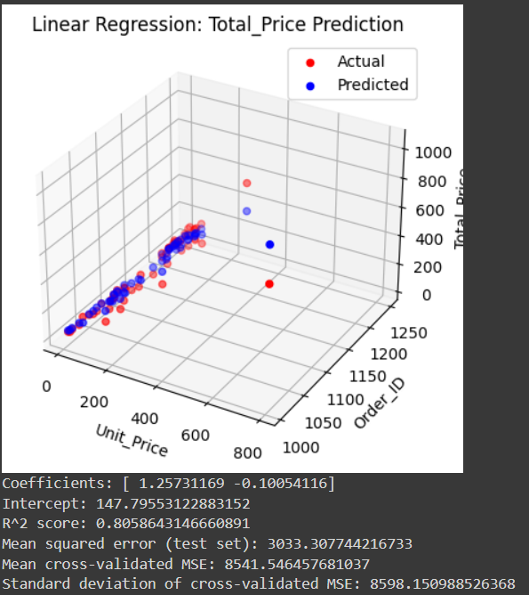

Slide 7
Logistic Regression with Single Variate
Logistic regression is a statistical method used for binary classification, where the dependent variable is categorical with two possible outcomes. It models the probability of a certain class or event occurring by applying a logistic function to a linear combination of the independent variables, producing an output between 0 and 1 that can be interpreted as a probability.

Slide 8
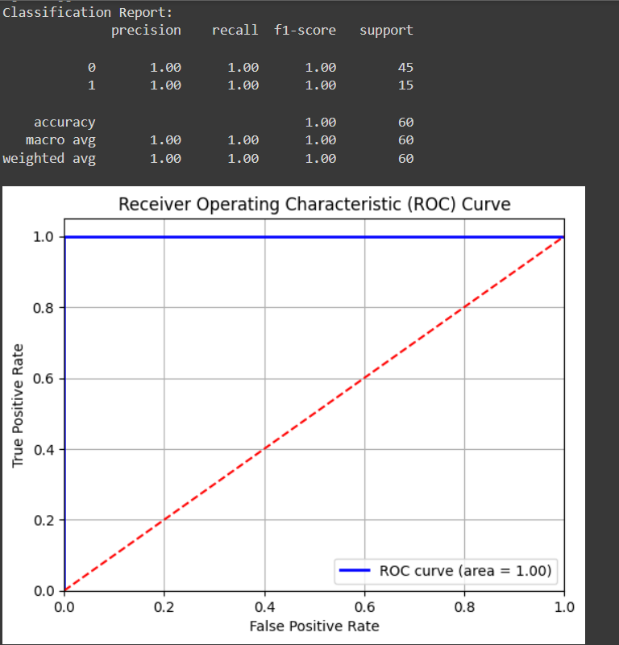

Slide 9
Logistic Regression with MultiVariate
Multivariate logistic regression is a statistical method used to model the relationship between a binary dependent variable and multiple independent variables. It estimates the probability that a given input belongs to a particular category (typically coded as 0 or 1) using the logistic function.

Slide 11
T – Test
A t-test is a statistical method used to compare the means of two groups to determine if they are significantly different from each other. It assesses whether the observed difference between the sample means is likely to have occurred by chance, considering the sample size and variability. T-tests are commonly used in hypothesis testing for comparing sample means to a known value or to each other.

Slide 12
K - Fold Classification
K-fold classification is a cross-validation technique used to assess the performance and generalizability of a classification model. The dataset is divided into *k* equal-sized subsets, or "folds." The model is trained on *k-1* folds and tested on the remaining fold. This process is repeated *k* times, with each fold serving as the test set once. The results are averaged to provide a more robust estimate of the model's performance.

Slide 14
McNemar Test
The McNemar test is a statistical method used to compare the performance of two classification models on paired nominal data, typically in a 2x2 contingency table. It assesses whether there is a significant difference in the classification accuracy between the models, specifically focusing on the instances where they disagree. The test is particularly useful for evaluating changes in a binary outcome before and after an intervention or when comparing two classifiers on the same dataset.

Slide 15
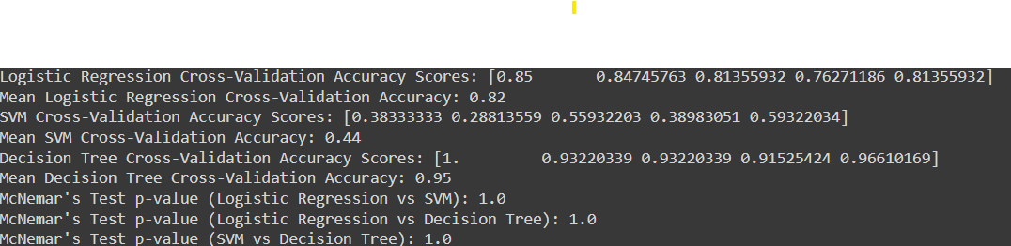

Slide 16
Random Forest
Random Forest is a versatile and widely used machine learning algorithm that belongs to the ensemble learning category. It can be used for both classification and regression tasks. The key idea behind Random Forest is to combine the predictions of multiple decision trees to improve accuracy and robustness, reducing the likelihood of overfitting.

Slide 17
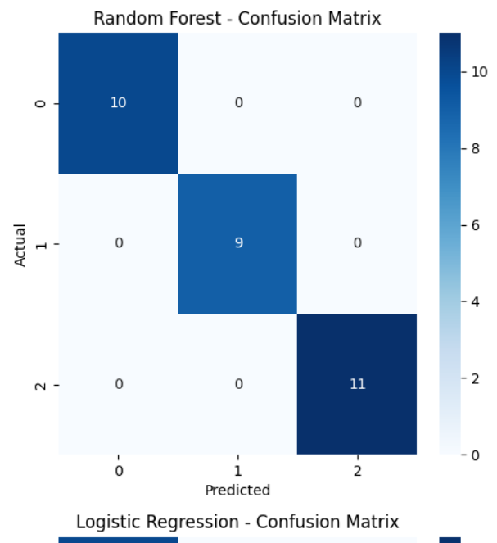

Slide 18
Decision Tree
A Decision Tree is a supervised machine learning algorithm used for both classification and regression tasks. It works by splitting the data into subsets based on the values of input features, creating a tree-like structure where each internal node represents a decision based on a feature, and each leaf node represents an outcome (class label or continuous value).

Slide 19


Slide 20
L1-Lasso
L1 regularization (also called Lasso regression in the context of linear regression) is a technique used to prevent overfitting by adding a penalty term to the loss function based on the absolute values of the model's weights. It encourages the model to reduce the influence of less important features by shrinking some weights to exactly zero.
Cost Function=Loss Function+λi=1∑n​∣wi​∣
Loss Function: Measures the error (e.g., mean squared error for linear regression).
λ\lambdaλ: Regularization parameter that controls how much penalty is applied.
∑∣wi∣\sum |w_i|∑∣wi​∣: The sum of the absolute values of the model’s weights wiw_iwi​.
The larger λ\lambdaλ is, the more regularization you apply, encouraging more weights to become zero.

Slide 21
Lasso regression model to predict total sales price based on features like unit price, quantity, and product name. It splits the data into training and testing sets, fits the model, and evaluates it using mean squared error (MSE) and R-squared values for both sets. The model's coefficients are printed at the end. The alpha parameter controls the strength of the regularization in Lasso regression, where higher values lead to more regularization, potentially shrinking some coefficients to zero to enforce sparsity and reduce overfitting.

Slide 22
L2- Ridge
L2 regularization (also known as Ridge regression in linear models) is another technique used to prevent overfitting in machine learning models. Unlike L1 regularization, which penalizes the absolute values of the weights, L2 regularization penalizes the squared values of the weights. This technique reduces the model complexity by shrinking the weights toward smaller values, but unlike L1, it rarely drives them exactly to zero.
Cost Function=Loss Function+λi=1∑n​wi2​Loss Function: Measures the error (e.g., mean squared error for linear regression).
λ\lambdaλ: Regularization parameter that controls how much penalty is applied.
∑wi2\sum w_i^2∑wi2​: The sum of the squared values of the model’s weights wiw_iwi​.

Slide 23
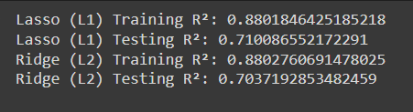
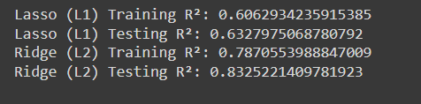
Before :
After :

Slide 24
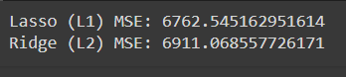

Slide 25
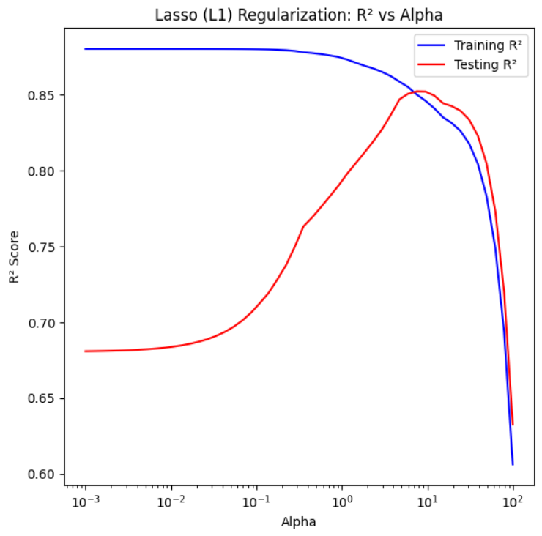

Slide 26
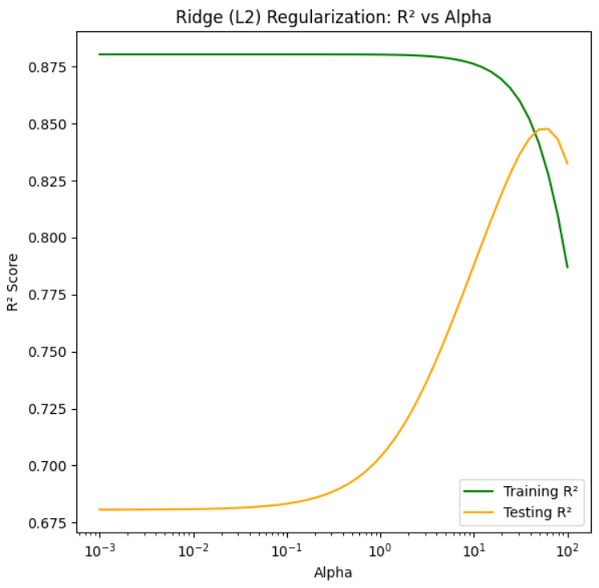

Slide 27
KNN
KNN operates based on the idea that similar data points are likely to be close to each other. To classify or predict the value of a new data point, KNN looks at its closest neighbors in the training data.
K (Number of Neighbors): This is a crucial hyperparameter. A small K may lead to overfitting (the model may be too sensitive to noise), while a large K may smooth out the predictions but also reduce accuracy.
Distance Metric: The choice of distance metric impacts the model’s performance. For example, Euclidean distance works well in many cases, but for higher-dimensional data or specific applications, another metric may be more appropriate.

Slide 28
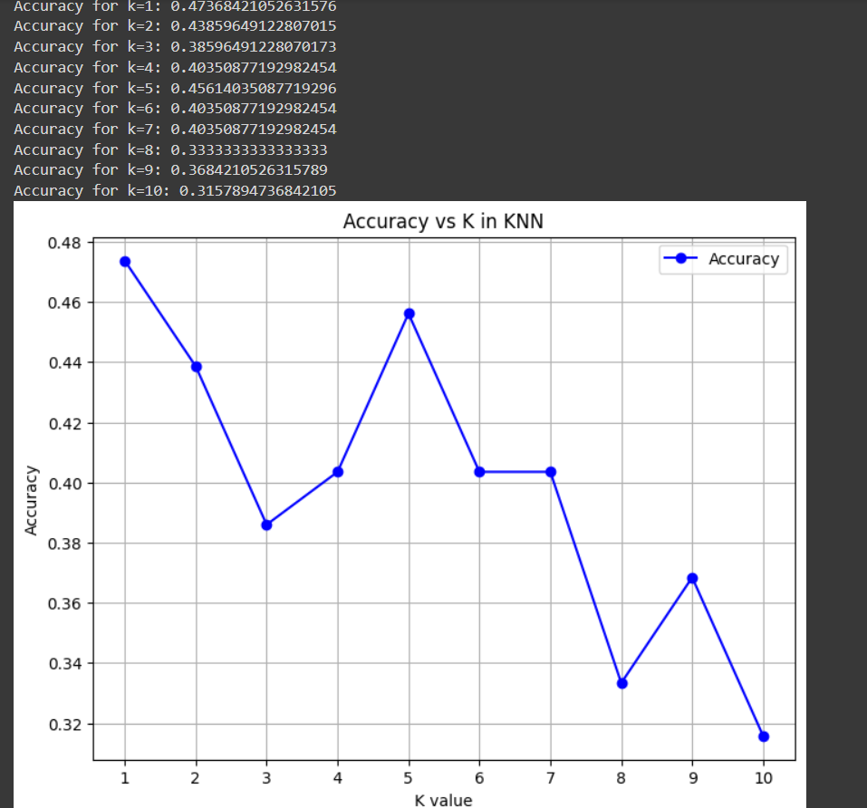

Slide 29
Thank you!
VaraPrasad Raju – RA2211056010106.
Pinisetti Govardhan – RA2211056010107.
Reddi Mohan Vamsi – RA2211056010109.

